Slide 1
产品分析报告
for
某食品批发商

Slide 2
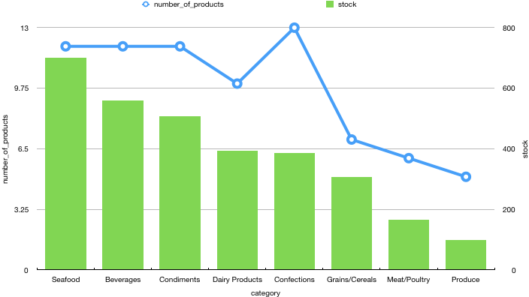
产品分销情况
每个类别中的产品名称和库存数量分布趋势相同
甜品类别中商品名称高于其他类别
Notes:
SELECT c.categoryname AS category, COUNT(*) AS number_of_products, SUM(p.unitsinstock) AS stock
FROM Categories c
JOIN Products p
ON c.categoryid=P.categoryid
GROUP BY 1
ORDER BY 3 DESC;

Slide 3
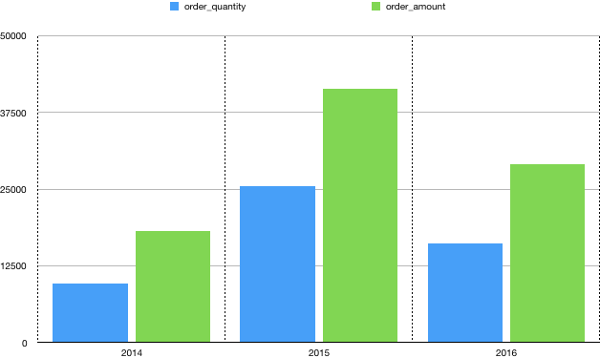
订单情况
2015年，订单数量和金额都是最高的
2016年相比于2015年订单数量和金额都有下滑，但相对于2014年均有增长
Notes:
SELECT STRFTIME('%Y', o.orderdate) AS year, SUM(od.quantity*od.unitprice*od.discount) AS order_amount, SUM(od.quantity) AS order_quantity
FROM orders o
JOIN orderdetails od
ON o.orderid=od.orderid
GROUP BY 1
ORDER BY 1;

Slide 4
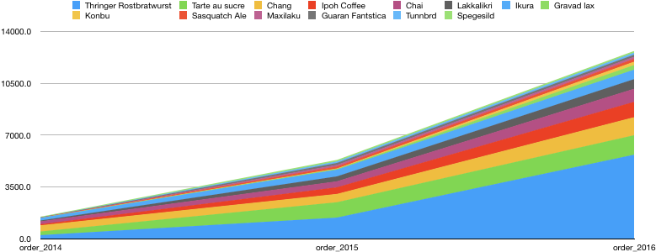
增长的产品
虽然总体而言，2016年我们的订单金额与2015年相比呈负增长趋势，但2016年和2015年的以下产品均与往年相比均有销售增长
Notes:
SELECT t1.product_name AS product_name, t1.order_amount AS order_2016, t2.order_amount AS order_2015, t3.order_amount AS order_2014
FROM
(SELECT STRFTIME('%Y', o.orderdate) AS date_2016, p.productname AS product_name, p.productid, SUM(od.quantity*od.unitprice*od.discount)
AS order_amount
FROM orders o
JOIN orderdetails od
ON o.orderid=od.orderid
JOIN products p
ON od.productid=p.productid
WHERE STRFTIME('%Y', o.orderdate)='2016'
GROUP BY 2
ORDER BY 3 DESC) t1
JOIN
(SELECT STRFTIME('%Y', o.orderdate) AS date_2015, p.productname, p.productid, SUM(od.quantity*od.unitprice*od.discount) AS order_amount
FROM orders o
JOIN orderdetails od
ON o.orderid=od.orderid
JOIN products p
ON od.productid=p.productid
WHERE STRFTIME('%Y', o.orderdate)='2015'
GROUP BY 2
ORDER BY 3 DESC) t2
ON t1.productid=t2.productid
JOIN
(SELECT STRFTIME('%Y', o.orderdate) AS date_2014, p.productname, p.productid, SUM(od.quantity*od.unitprice*od.discount) AS order_amount
FROM orders o
JOIN orderdetails od
ON o.orderid=od.orderid
JOIN products p
ON od.productid=p.productid
WHERE STRFTIME('%Y', o.orderdate)='2014'
GROUP BY 2
ORDER BY 3 DESC) t3
ON t2.productid=t3.productid
WHERE order_2016>order_2015 AND order_2015>order_2014
GROUP BY 1
ORDER BY 2 DESC

Slide 5
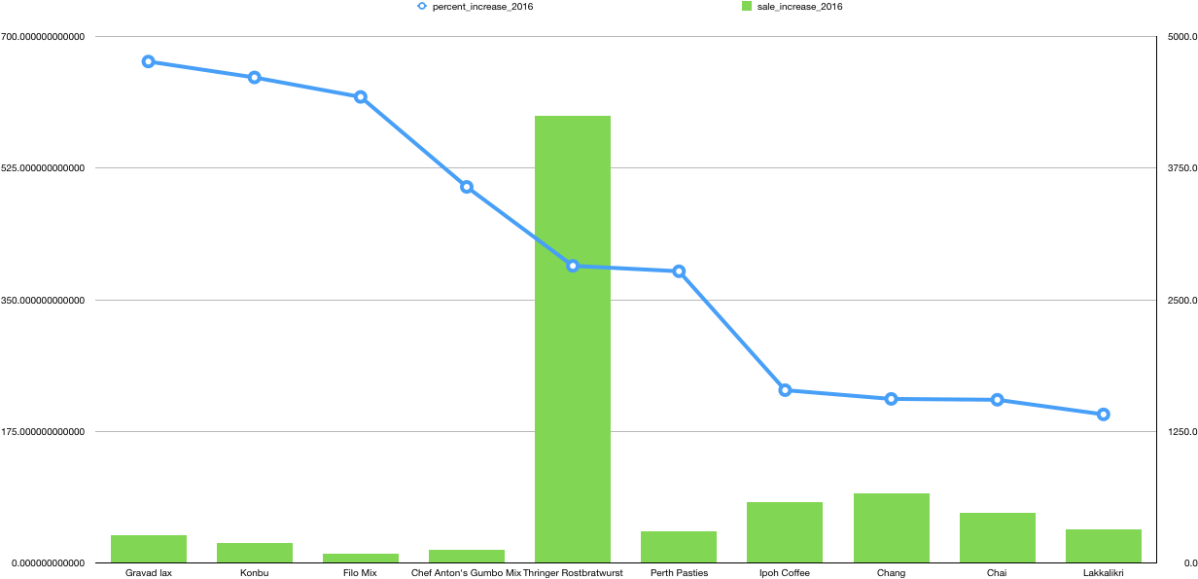
畅销产品 Top 10
这里只讨论2016年与2015年，因为我们对最近的产品订单增长更感兴趣
可以注意到，增长最快的产品在数量增加和百分比增加方面是不同的：我们可以根据产品的高单价实现最高的增长量
另一方面，高增长百分比意味着产品销售真正增加并且比仅在数量增加的情况下快得多
我们应首先集中精力在数量和百分比增长都很快的产品上，以提高我们的销售水平
Notes:
SELECT product_name AS product_name, SUM(order_2016-order_2015) AS sale_increase_2016, (order_2016)*100/(order_2015) AS percent_increase_2016
FROM
(SELECT t1.product_name AS product_name, t1.order_amount AS order_2016, t2.order_amount AS order_2015
FROM
(SELECT STRFTIME('%Y', o.orderdate) AS date_2016, p.productname AS product_name, p.productid, SUM(od.quantity*od.unitprice*od.discount)
AS order_amount
FROM orders o
JOIN orderdetails od
ON o.orderid=od.orderid
JOIN products p
ON od.productid=p.productid
WHERE STRFTIME('%Y', o.orderdate)='2016'
GROUP BY 2
ORDER BY 3 DESC) t1
JOIN
(SELECT STRFTIME('%Y', o.orderdate) AS date_2015, p.productname, p.productid, SUM(od.quantity*od.unitprice*od.discount) AS order_amount
FROM orders o
JOIN orderdetails od
ON o.orderid=od.orderid
JOIN products p
ON od.productid=p.productid
WHERE STRFTIME('%Y', o.orderdate)='2015'
GROUP BY 2
ORDER BY 3 DESC) t2
ON t1.productid=t2.productid) t3
GROUP BY 1
ORDER BY 3 DESC
LIMIT 10

